Slide 1



ConnectTel
Customer Churn Prediction by Machine Learning
Presented By:
Esopere Yannick Esopere

Slide 2

1. Project Background
ConnectTel is a prominent telecommunications company, with a well-established presence in the global market.
It provides reliable voice, data, and internet services for both individual and corporate customers.
The company is heavily invested in technological innovation to ensure a continuous and seamless communication experience for millions of its global customers.
However, the company faces challenges relative to customer churn and intends to device proactive measures to reduce customer attrition and enhance customer loyalty.
ConnectTel seeks to maintain a competitive edge in the highly dynamic and competitive telecommunications industry.

Slide 3

2. Problem Statement
Potential Benefits:
Cost-effective retention of existing customers, thereby securing revenue retention.
Better precision in recording and monitoring the statistics for actual customers and churned customers over time.
Identifying the causes of customer churn and customer groups with higher churn probability.
Proactive implementation of causal-based solutions aimed at reducing customer churn probability.
The company's current customer retention strategies lack precision and effectiveness, resulting in the loss of valuable customers to competitors.
This poses a significant threat to its business sustainability and growth.
Project Objective:
To create a robust customer churn prediction system, which accurately forecast customer churn and provides insight for implementing targeted retention initiatives.

Slide 4
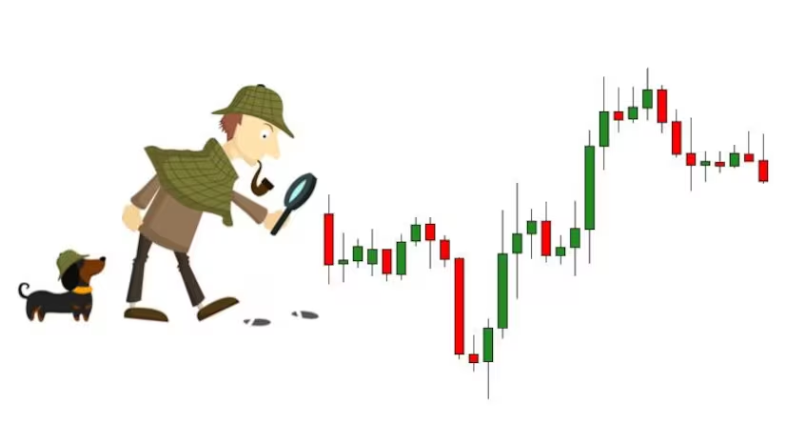
3. Data Mining & Exploratory Data
Analysis (EDA)
1. Data Mining:
Data source: ConnectTel customer dataset
Data Info:
21 Columns (4 numerical features and 17 categorical features).
7,043 Rows
Data Cleaning:
11 missing data points (o.002%) for 'TotalCharges’
Missing values were replaced with the median.
No duplicates.
New categorical features were created to classify numerical data for easier analysis.
Redundant data features were dropped (customer ID).
2. EDA:
Univariate Data Analysis
Bivariate Data Analysis
Multivariate Data Analysis

Slide 5
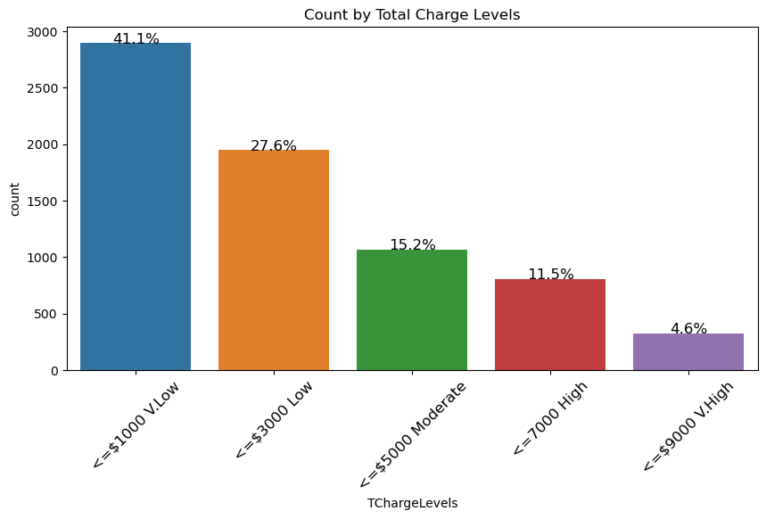
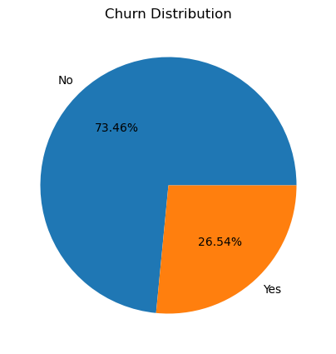
3.1. EDA – Univariate Analysis
A count of customers by category was performed for each Categorical feature.
Example:
Total number of customers – 7,043
Churned customers – 1,869
Not churned – 5,174
A count of customers by category was also performed for each Numerical feature.
No outliers were detected for numerical the features.

Slide 6
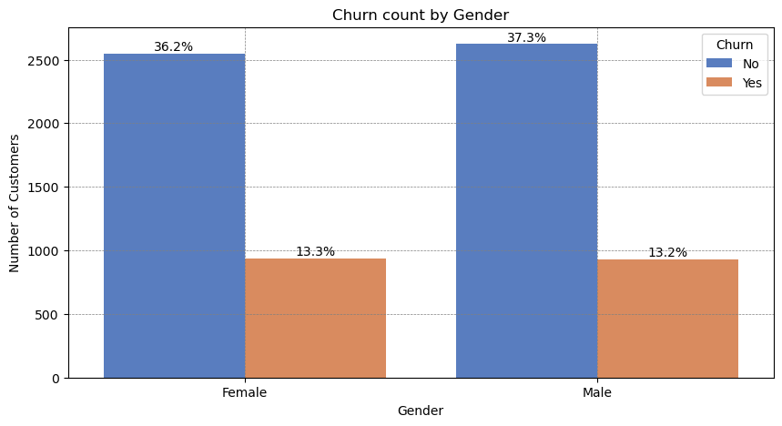
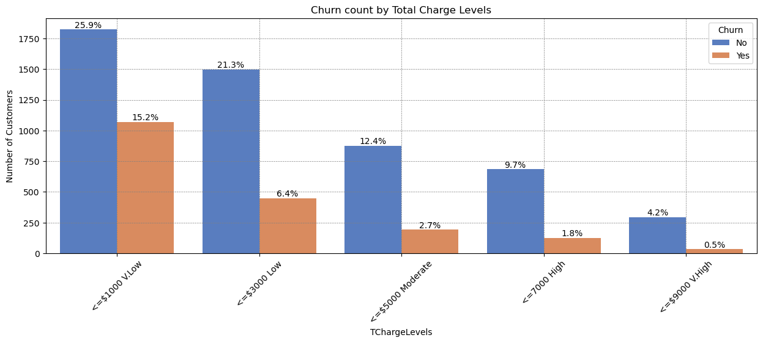
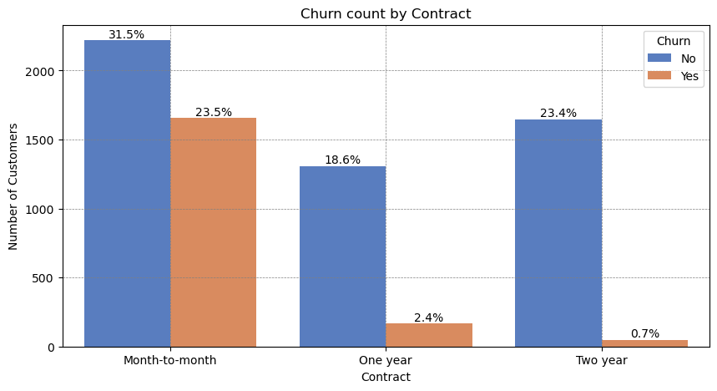
3.2. EDA – Bivariate Analysis
The target variable (Churn) was used to evaluate the customer count for each categorical and numerical feature.

Slide 7
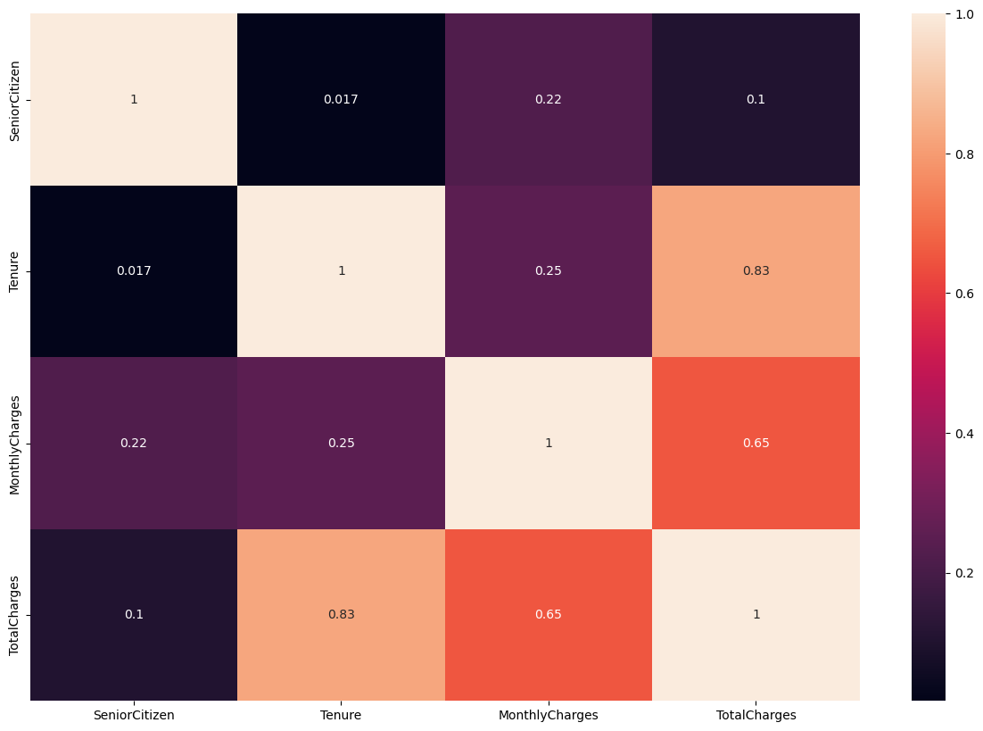
3.3. EDA – Multivariate Analysis
Pearson Correlation Matrix was applied to evaluate the relationship between the numerical features.
There was a strong correlation between:
Total Charges & Tenure (0.83)
Total Charges & Monthly Charges (0.65)

Slide 8


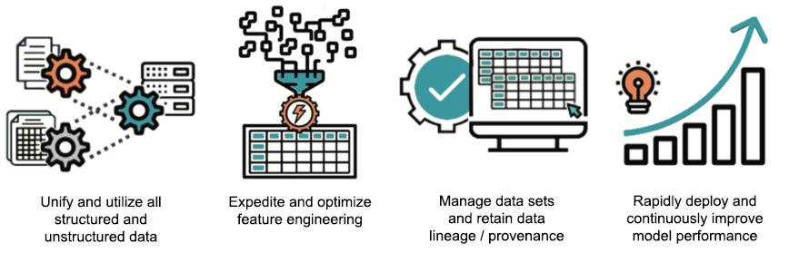

4. Feature Engineering & Data Preprocessing
Data Preprocessing
The dataset was segmented into input features and the output features for further preprocessing.
2. Feature Encoding
Binary Feature Encoding: Pandas Replace Technique.
Ordinal Feature Encoding: Ordinal Mapping Technique.
Nominal Feature Encoding: One-Hot Encoding Technique.
Target Feature Encoding: Label Encoding Technique.
3. Feature Scaling
The Min-max scaler was used to scale the input features.
4. Feature Importance & Selection
The Random Forest Regressor function was applied to gauge the top 20 important input variables.
The Pearson correlation matrix was used to identify highly correlated input variables.

Slide 9


5.1. Model Building & Machine Learning
1. Model Building
The encoded dataset was split into training (80%) and testing (20%) datasets.
Based on the correlation matrix applied to the input features, 1 variable was dropped from every pair of highly correlated features above a threshold of 0.85.
The resulting data frame was used for machine learning.
2. Machine Learning
6 ML algorithms were fitted on the training dataset and model predictions were made on the testing dataset.
Random Forest Classifier
Decision Tree Classifier
XG Boost Classifier
K Neighbors Classifier
Support Vector Classifier (SVC)
Logistic Regression

Slide 10
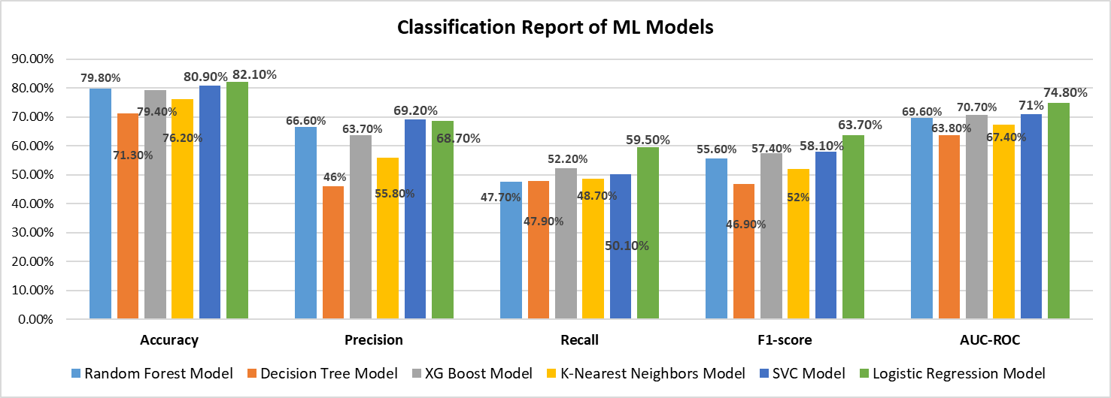
5.2. Model Evaluation by Metrics
 |  | Accuracy | Precision | Recall | F1-score | AUC-ROC
1 | Random Forest Model | 79.8% | 66.6% | 47.7% | 55.6% | 69.6%
2 | Decision Tree Model | 71.3% | 46% | 47.9% | 46.9% | 63.8%
3 | XG Boost Model | 79.4% | 63.7% | 52.2% | 57.4% | 70.7%
4 | K-Nearest Neighbors Model | 76.2% | 55.8% | 48.7% | 52% | 67.4%
5 | SVC Model | 80.9% | 69.2% | 50.1% | 58.1% | 71%
6 | Logistic Regression Model | 82.1% | 68.7% | 59.5% | 63.7% | 74.8%

Slide 11
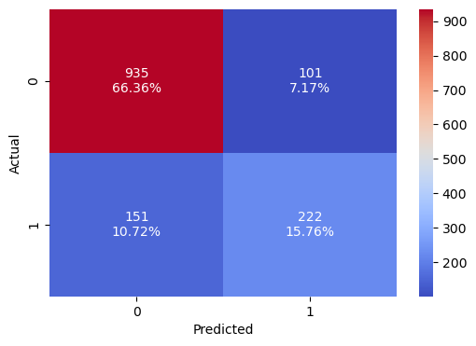
5.3. Model Evaluation by Confusion Matrix
The model sensitivity indicates only 59.5% of True Positives were accurately predicted.
This implies the model predicted a lot of False Negatives.
Customers predicted to have not churned, but who have actually churned.
True Negatives were accurately predicted to an acceptable level (90.2%).
However, the model must be fine tuned to reduce False Positives (increase Precision) and more especially False Negatives (increase Recall).
TN
FP
FN
TP
Logistic Regression Confusion Matrix
0 = Have not Churned
1 = Have Churned
Sensitivity = TP/(TP + FN): 59.5%
Specificity = TN/(TN+ FP): 90.2%

Slide 12

Recommendations & Conclusion
To maintain business competitiveness, attain business objectives, and reduce customer attrition, ConnectTel must focus on minimizing false negatives as this will have a more negative financial impact as concerns revenue maintenance.
Data-driven Customer Segmentation:
Apply advance analytics to segment customers according to their behavior, preferences, consumption patterns, and demographics in order to implement various retention strategies for different customer segments.
Customized Retention Strategies:
Deploy machine learning models to predict churn probability for various customer segments in order to tailor retention offers to meet specific preferences when the probability of potential customer churn is high.
Application of customer feedback analysis for tailored enhancement of customer experience.
Implementation of periodic competitive price revisions and incentive package offering to maintain customer loyalty (e.g Seasonal discounts, package discounts and long-term customer reward schemes).

Slide 13

Thank You
Creator: priyanka gupta
Credit: Getty Images/iStockphoto

